Slide 1
Using Drones for SAR in Man Overboard Situations On Cruise Ships

Slide 2
Outline
Introduction
Problem Statement
Proposed Client
Background
Existing Technology
Proposed Project
Requirements
Goals
Deliverables
Task Delineation
Testing
Conclusion
Q/A
Notes:
3.5 foot waves at a a mile away.
45 seconds
24 knots
Several ship lengths

Slide 3
Problem statement I
When a person goes overboard on a cruise ship, 80% of the time, they die. There are many reasons for this, but 2 important ones are that:
Even if the MOB is immediately noticed, it can be difficult to not lose sight of them.
If you are not noticed going overboard cruise ships will do a head count to confirm someone is missing.
http://www.cruisejunkie.com/Overboard.html
Introduction
Notes:
3.5 foot waves at a a mile away.
45 seconds
24 knots
Several ship lengths

Slide 4
Problem statement I
When a person goes overboard on a cruise ship, 80% of the time, they die. There are many reasons for this, but 2 important ones are that:
Even if the MOB is immediately noticed, it can be difficult to not lose sight of them because of turnaround time.
If you are not noticed going overboard cruise ships will do a head count to confirm someone is missing.
http://www.cruiseserver.net/travelpage/other/man_overboard.asp
Introduction
Notes:
3.5 foot waves at a a mile away.
45 seconds
24 knots
Several ship lengths

Slide 5
Problem statement II
Problems with cruise ship MOB SAR
Distance to turn cruise ship around
No aircraft on board and coast guard could be hours away
No good way to find someone in the dark
Introduction

Slide 6
Proposed Client
A major cruise ship company such as:
Carnival
Royal Caribbean International
Regent Seven Seas Cruises
Why?
Big Budgets
Cruise Vessel Safety and Security Act (2010)*
*https://www.uscg.mil/hq/cg2/cgis/Docs/HR3360CruiseVesselSecurityandSafetyActof2010.pdf
Introduction
Notes:
The vessel shall integrate technology that can be used for capturing images of passengers or detecting passengers who have fallen overboard, to the extent that such technology is available.

Slide 7
Existing Technology
Drones equipped for SAR
Universal Drone Ground Control Software
Location history tracking by Google
Ocean current tracking by NASA
Background

Slide 8
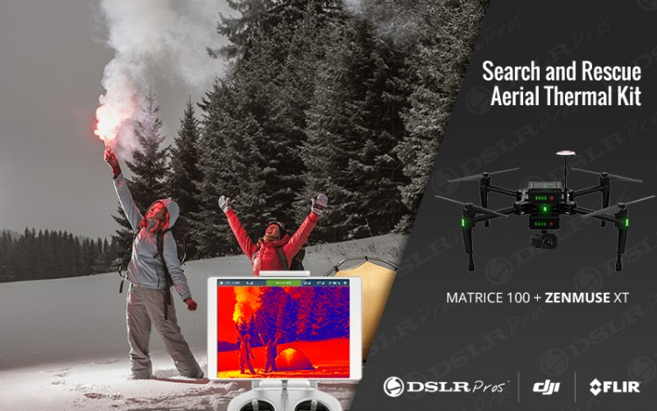
DJI Matrice 100 SAR Aerial Kit
DJI Matrice 100 Drone
$3,300
DJI Zenmuse XT Camera
$6,900
Accessories
GPS tracker, extra batteries, case, etc
$2,100
Total Cost: $12,140
Background
Notes:
Image: http://www.dslrpros.com/15/thermal-imaging/matrice-100-thermal/dji-matrice-100-search-rescue-aerial-kit.html

Slide 9
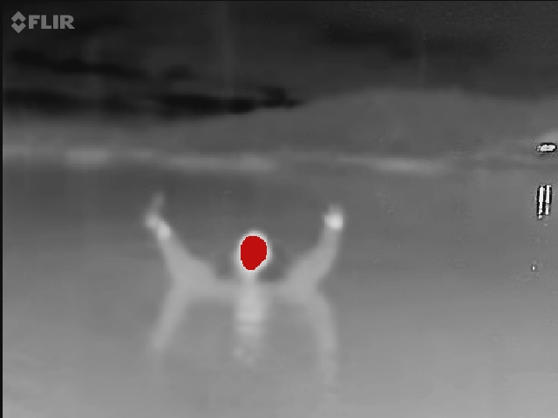
DJI Matrice 100 SAR Aerial Kit
FLIR technology
30 minutes of flight time
3.5 mile range
GPS Tracking
Background
Notes:
Image: http://pocketmariner.com/boatbeaconflirone/

Slide 10
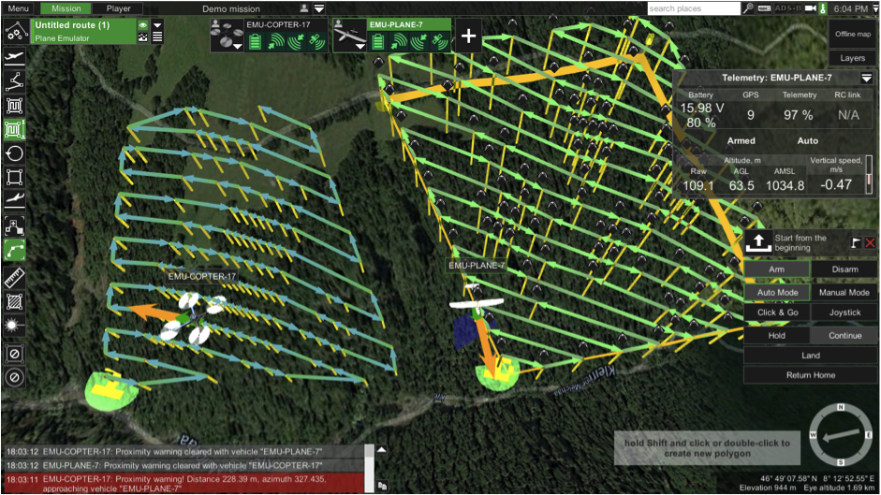
Universal Ground Control Software
Multi-drone ground control system
Supports GPS tracking
Modular Design
Easy creation of routes
Paid version has video recording and camera footprint features ($65)
Open Source version available
Background

Slide 11
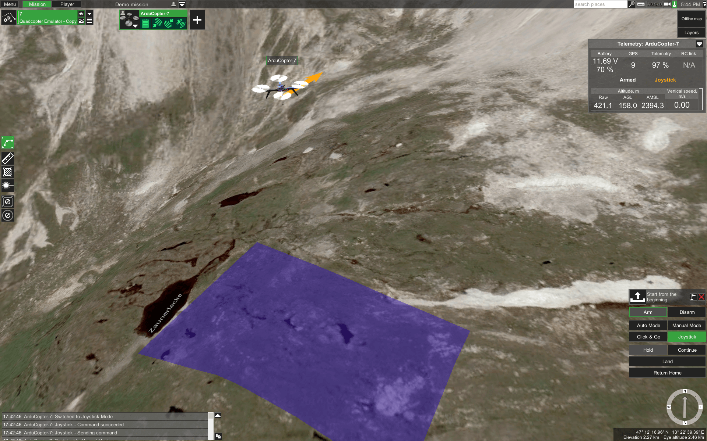
Universal Ground Control Software
Multi-drone ground control system
Supports GPS tracking
Modular Design
Easy creation of routes
Paid version has video recording and camera footprint features ($65)
Open Source version available

Slide 12
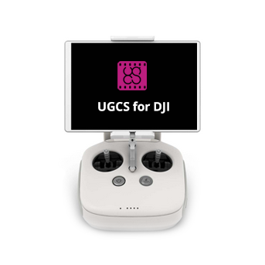
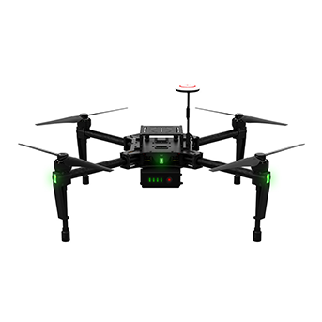
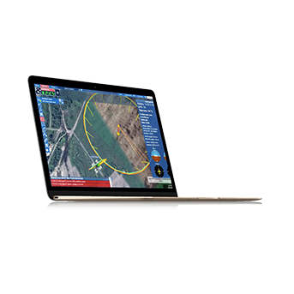
Universal Ground Control Software
Multi-drone ground control system
Supports GPS tracking
Modular Design
Easy creation of routes
Paid version has video recording and camera footprint features ($65)
Open Source version available
Background

Slide 13
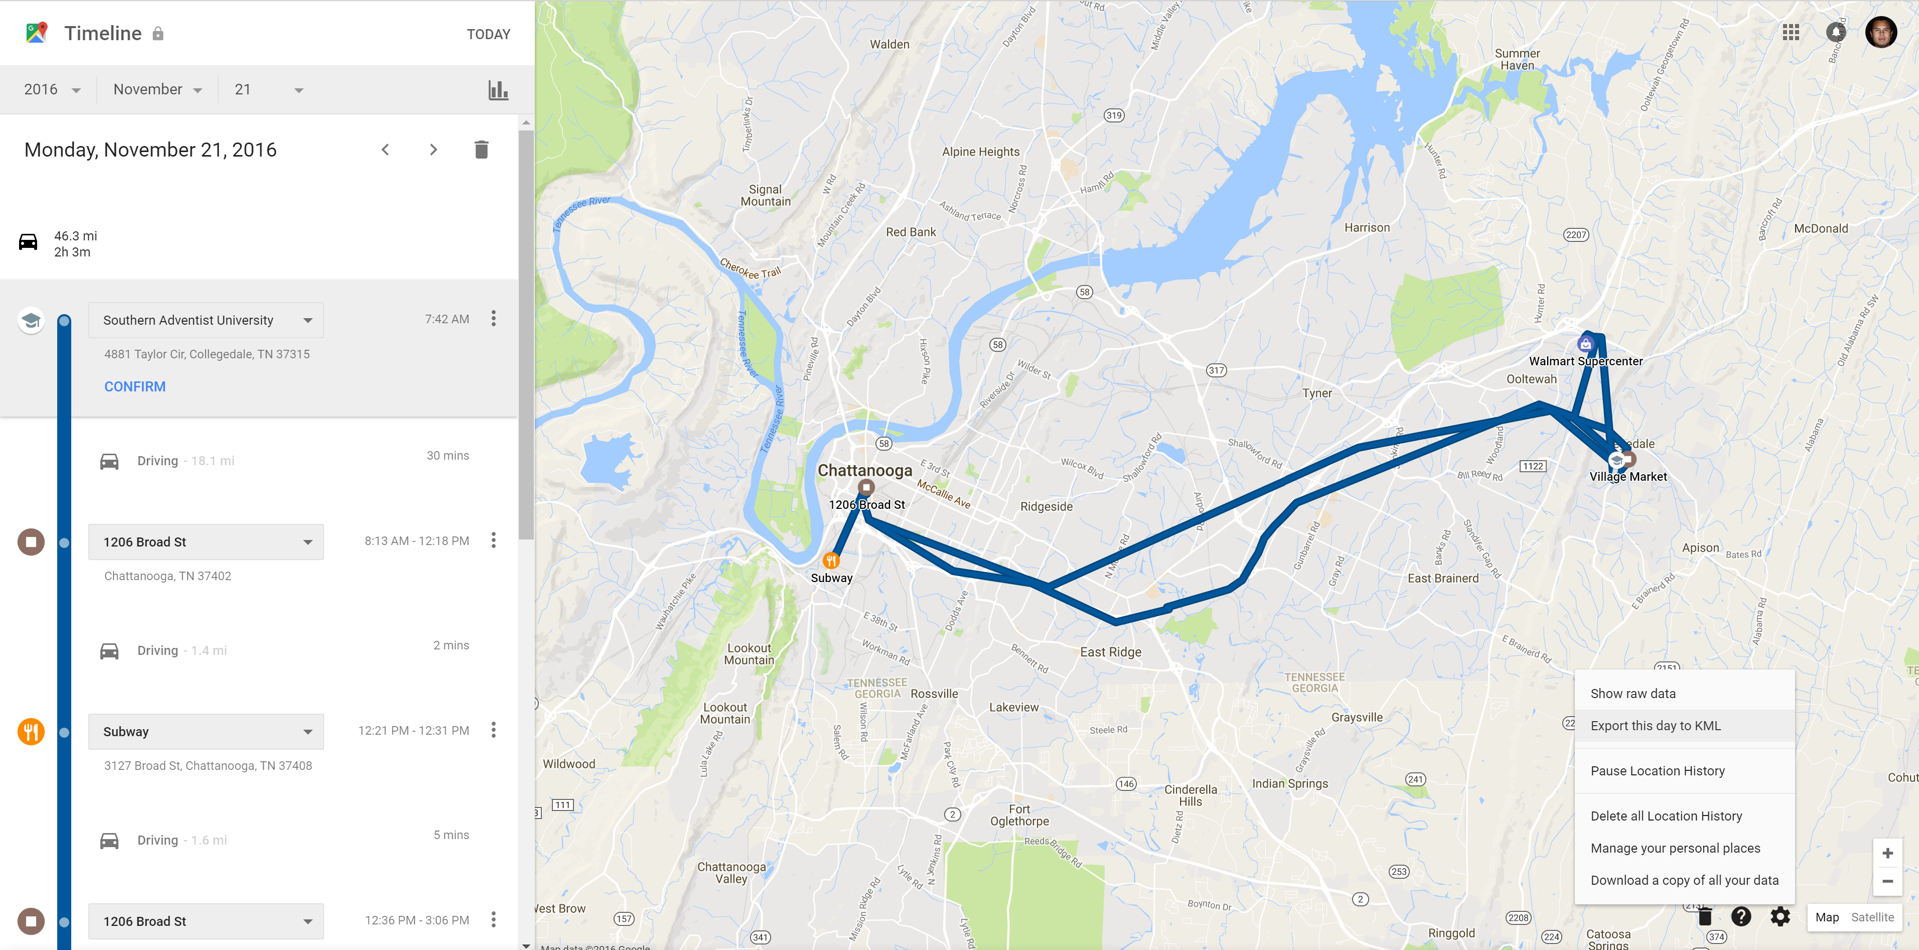
Google Location History

Slide 14
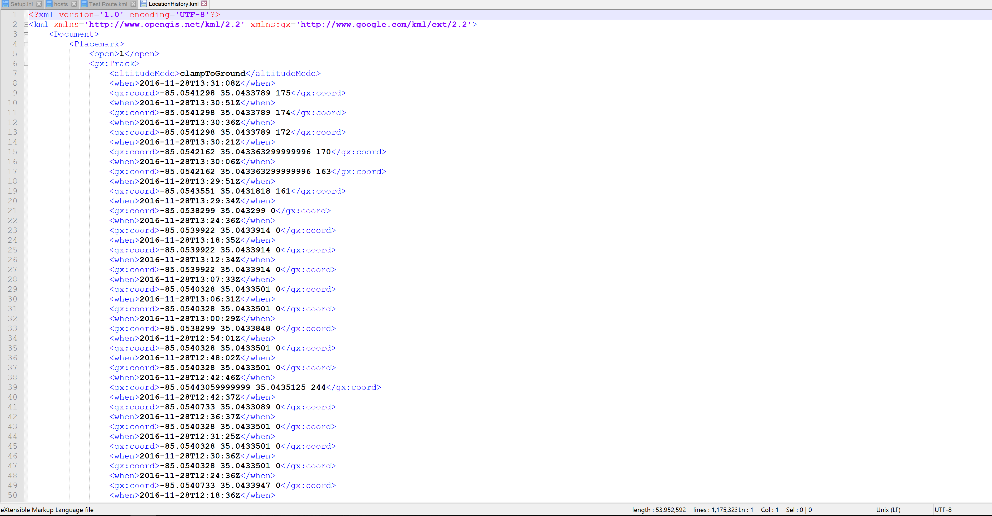
Google Location History

Slide 15
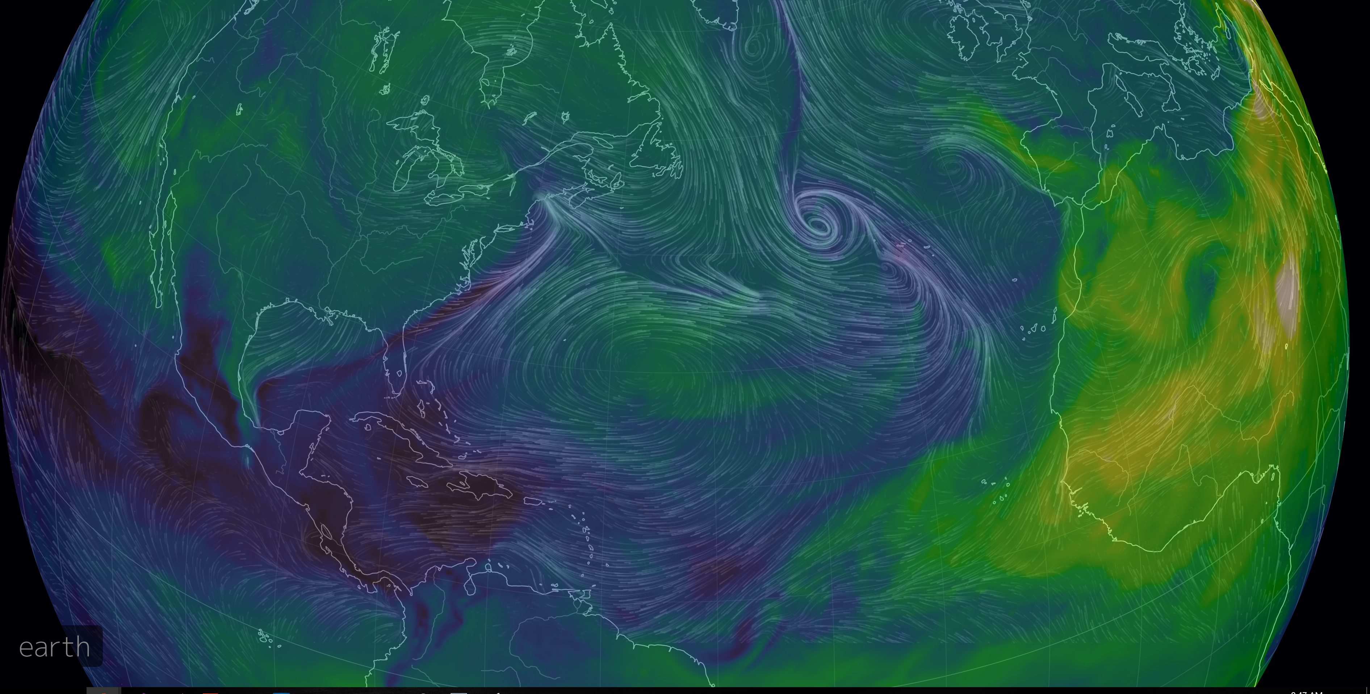
Ocean Current Tracking

Slide 16
Proposed Project
Description
Major tasks/milestones
Deliverables
Hardware/software requirements
Timeline
Team organization
Notes:
https://www.ugcs.com/en/features/post-flight-analysis-and-image-processing

Slide 17
Project Description
A stand-alone application that creates a route file that UGCS can import given the time of MOB incident, time of SAR operation start, and number of drones available
Notes:
https://www.ugcs.com/en/features/post-flight-analysis-and-image-processing

Slide 18
Major Tasks/Milestones
Figure out the API to get location data from Google
Parse location data
Automate gathering ocean current data
Parse ocean current data
Figure out route algorithm based on MOB time, SAR start time, and drones available
Reverse engineer route file format for UGCS
Write stand-alone application to automate route file creation given time of MOB incident and number of drones available.
Notes:
https://www.ugcs.com/en/features/post-flight-analysis-and-image-processing

Slide 19
Deliverables
A stand-alone application that creates a route file that UGCS can import given the time of MOB incident, time of SAR operation start, and number of drones available
Notes:
https://www.ugcs.com/en/features/post-flight-analysis-and-image-processing

Slide 20
Hardware/Software Required
UGCS software, $65
Smart phone compatible with Google tracking.
Notes:
https://www.ugcs.com/en/features/post-flight-analysis-and-image-processing

Slide 21
Timeline
Figure out location API: 40 Hrs
Parse location data: 20 Hrs
Parse ocean current data 30 Hrs
Reverse engineer route file from UGCS: 30 Hrs
Write application: 25 Hrs
Testing: 20 Hrs
Notes:
https://www.ugcs.com/en/features/post-flight-analysis-and-image-processing

Slide 22
Team Organization
3 CS majors
Notes:
https://www.ugcs.com/en/features/post-flight-analysis-and-image-processing

Slide 23
Testing Plan
Notes:
https://www.ugcs.com/en/features/post-flight-analysis-and-image-processing

Slide 24
Conclusion
Notes:
https://www.ugcs.com/en/features/post-flight-analysis-and-image-processing

Slide 25
Solution Requirements
Ability to detect a human in the ocean day or night
Ability to control multiple drones both automatically and manually
Ability to send live video and GPS data to control center
Ability to automatically create search routes based on number of drones and time of incident

Slide 26
What Remains to be Done
Automation of route creation
Track areas searched/remaining to be searched
Integrate ocean current data in search area

Slide 27
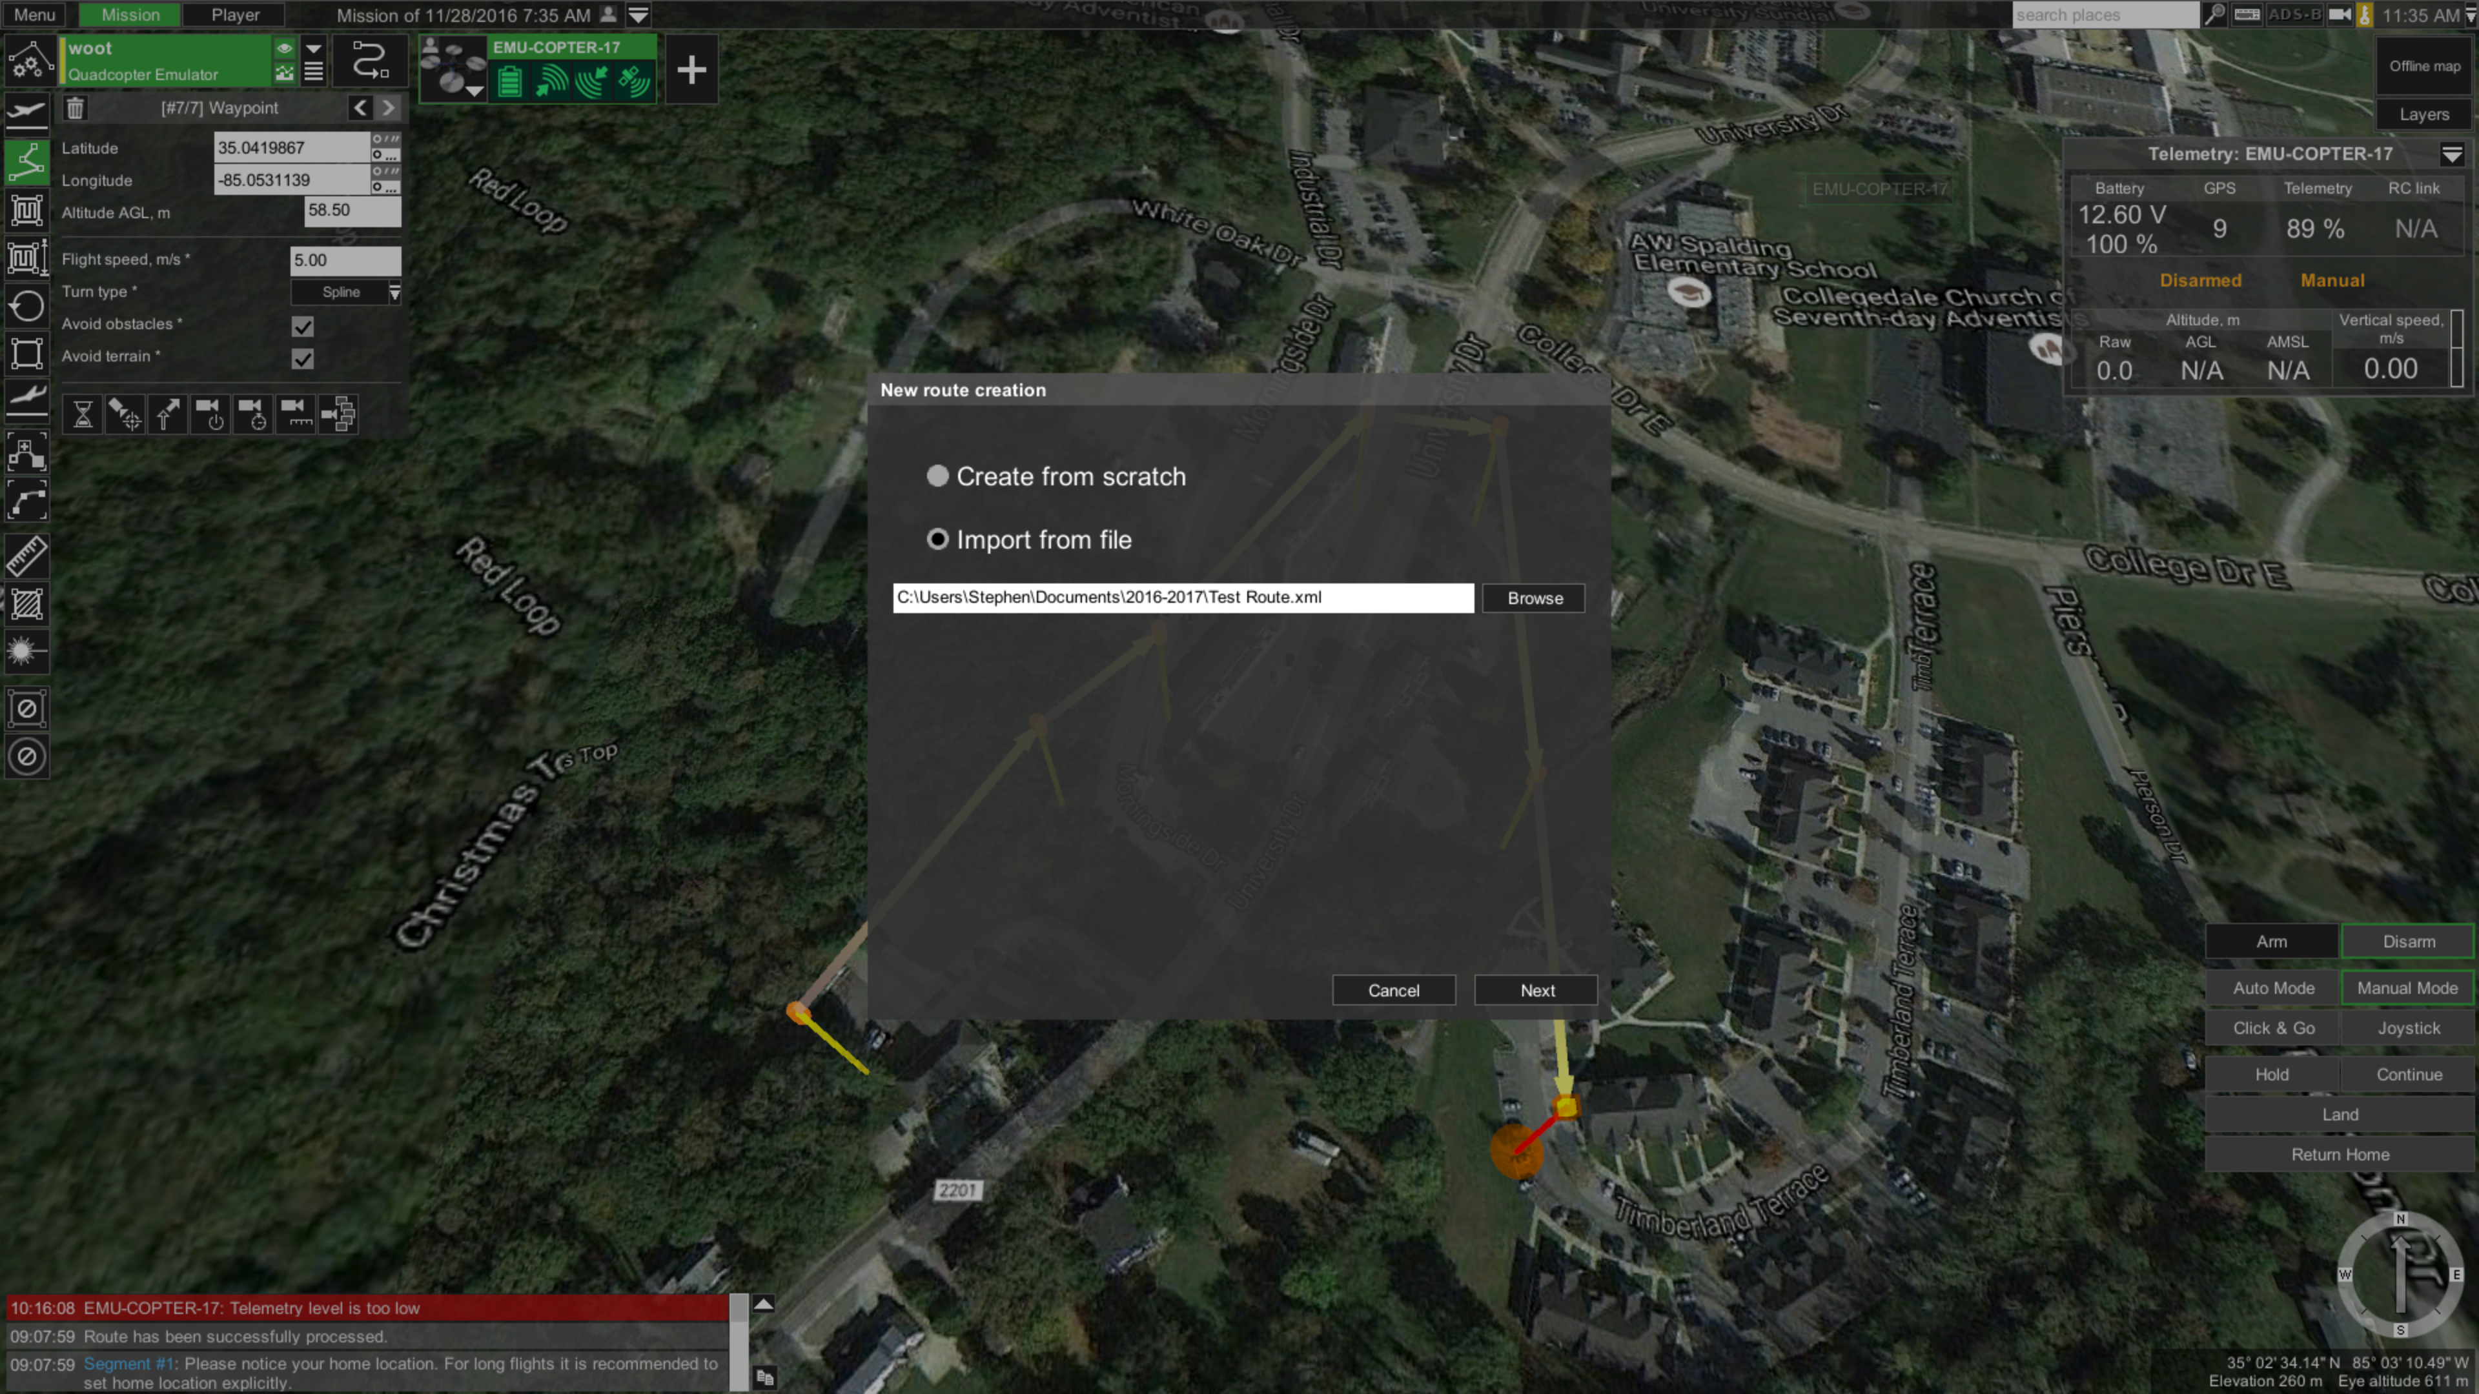
Automating Route Creation
User enters time of MOB incident
Search route file is automatically generated using
Location history data
Ocean current data
Search route is uploaded to UGCS and mission is started
Once person is located operator assumes manual control of drone

Slide 28
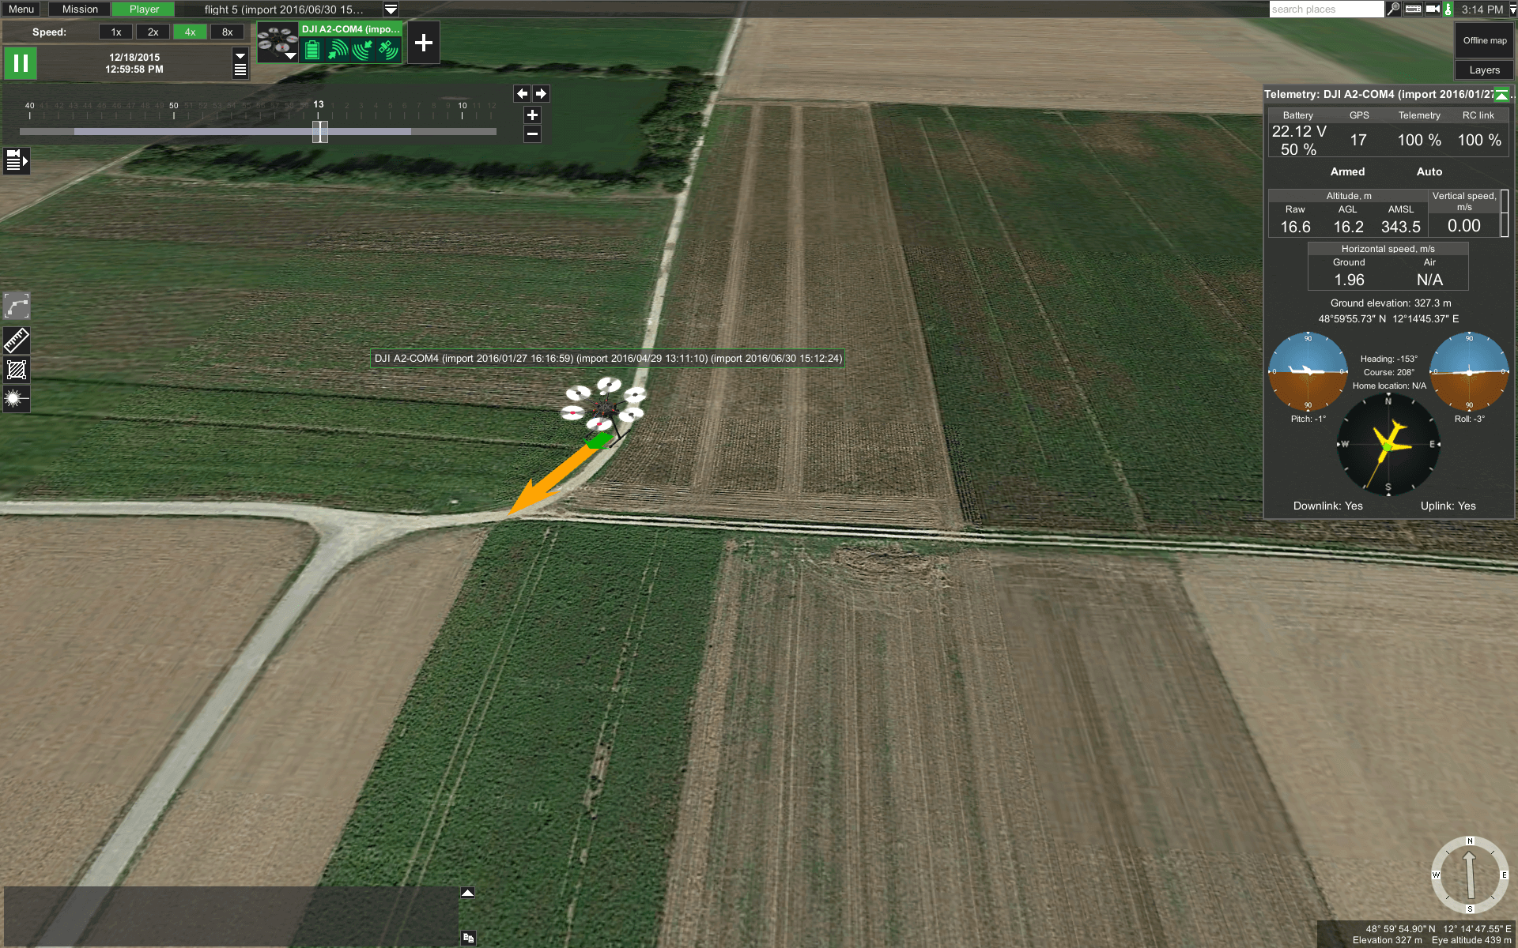
Keeping Track of Areas Searched
UGCS telemetry playback
All flight data is saved
Not sure if this can be exported yet
Notes:
https://www.ugcs.com/en/features/post-flight-analysis-and-image-processing

Slide 29
Keeping Track of Areas Searched
UGCS telemetry playback
All flight data is saved
Not sure if this can be exported yet
Notes:
https://www.ugcs.com/en/features/post-flight-analysis-and-image-processing

Slide 30
Keeping Track of Areas Searched
UGCS telemetry playback
All flight data is saved
Not sure if this can be exported yet
Notes:
https://www.ugcs.com/en/features/post-flight-analysis-and-image-processing

Slide 31
Keeping Track of Areas Searched
UGCS telemetry playback
All flight data is saved
Not sure if this can be exported yet
Notes:
https://www.ugcs.com/en/features/post-flight-analysis-and-image-processing

Slide 32
Keeping Track of Areas Searched
UGCS telemetry playback
All flight data is saved
Not sure if this can be exported yet
Notes:
https://www.ugcs.com/en/features/post-flight-analysis-and-image-processing

